Slide 1
CS 470 Project Two Conference Presentation: Cloud Development
Sean Toon
August 2024

Slide 2
Overview
About me!
Purpose of the presentation:
-Migration of full stack to cloud-native app
-AWS microservices
-Containerization and Orchestration
-Serverless Architecture
-Cloud-based development principles
Notes:
My name is Sean and I am a Cloud Engineer for the company Q&A. In this presentation, I will be sharing the benefits and processes of migrating a full stack application to a cloud- native application by using AWS services. I will be discussing topics and sharing examples of key aspects of cloud computing such as Containerization, Orchestration, Serverless architecture and cloud-based development principles.

Slide 3
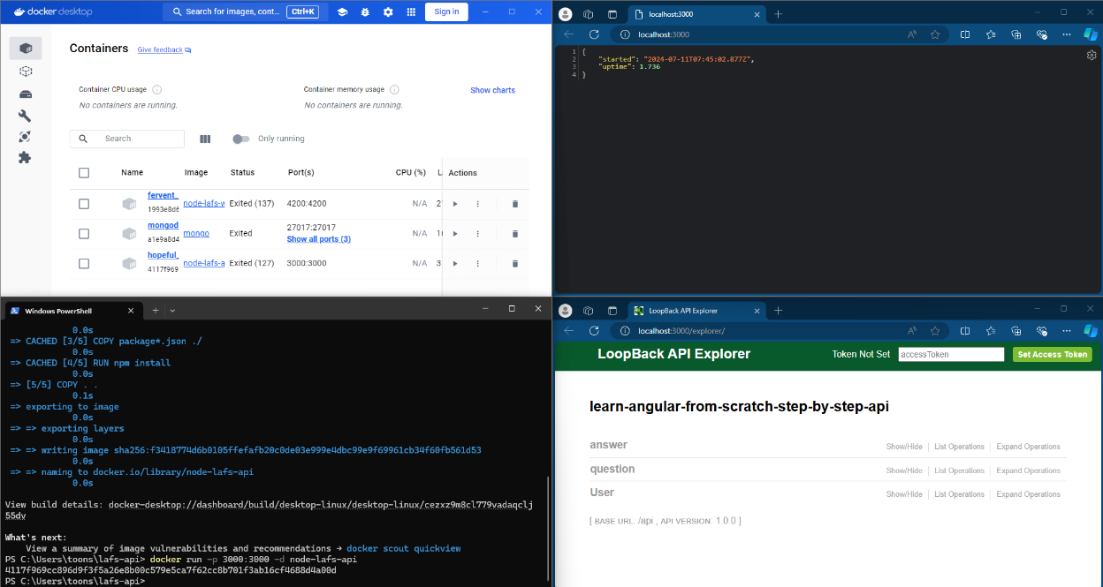
Containerization
Models used
Containers
What tools are necessary for containerization?
Docker
Docker Compose
Notes:
Containerization is the process of packaging applications and dependencies to simplify scaling and deployment for future application use. In this project I used Docker to create three different containers to host the front-end, back-end and the database. I then used Docker Compose to orchestrate all of the containers.

Slide 4
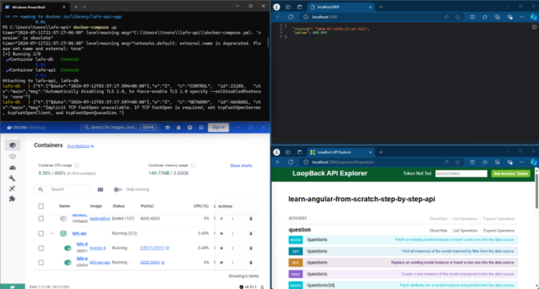
Orchestration
Values of using Docker Compose
Simplified Configuration
Multi-Container management
Efficient workflow
Scalability
Notes:
Docker compose helps orchestrate a multi-container Docker application. The tools autonomous features allow for simplified configuration and ultimately promotes efficient workflow by aiding in complex application management.

Slide 5
The Serverless Cloud
Serverless
Serverless and its advantages
Using someone else's servers
Managing servers
Cost of compute time and other resources
Operational and developmental complexity
Security
S3 storage compared to local storage
S3 Cloud storage
Local storage
Both store data and files
Differ in security, durability, scalability, and cost
Notes:
Serverless basically means to outsource for server use. The advantages of serverless development include saving on resources required to build and manage local servers. Serverless also saves time for both runtimes and development times.
S3 is an Amazon cloud storage service. Local and S3 storage is the same in the ways that they both store data and files, yet depending on the size of the project, S3 may offer a more secure, durable and scalable way to store data without the need to invest in expensive hardware.

Slide 6
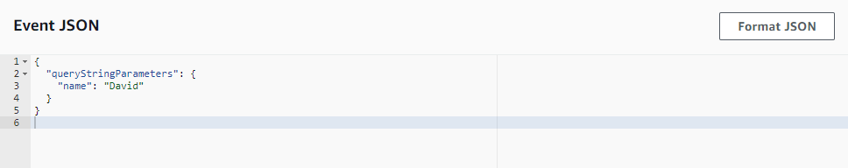
The Serverless Cloud
API & Lambda
Advantages of using a serverless API
Code development and deployment
Cost and compute time
Lambda API Logic
Event driven
Functions handle requests
API gateway or other sources
Scaling
Execution
Efficient routing and data handling
Scripts
Supports different coding languages
IAM roles and policies
Integrating the frontend with the backend
Lambda functions
API Endpoints
Frontend integration
Testing
Monitoring and debugging
Notes:
One advantage of using a serverless API is gaining access to the Lambda Compute Model. Lambda functions are triggered by events, and the functions handle requests. After handling a request the response is returned to the API Gateway or other sources. Because Lambda is event driven, it easily handles code deployment, scaling and execution automatically and in a resourceful way. It saves resources by lowering costs and compute times. Lambdas integration with API Gateway in this project, has allowed for efficient routing and data handling. In this project, I created many Lambda functions to integrate the frontend with the backend of my application. The process included steps of coding, deploying, testing, monitoring and debugging Lambda functions.

Slide 7
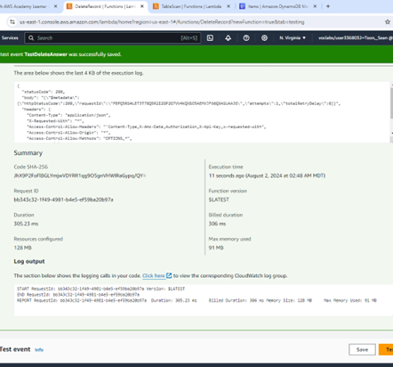
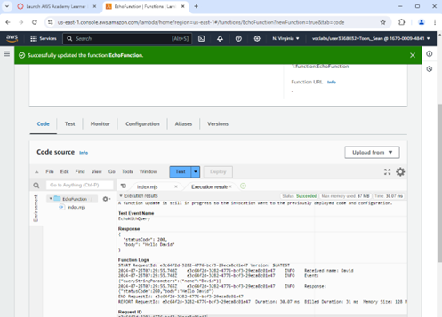
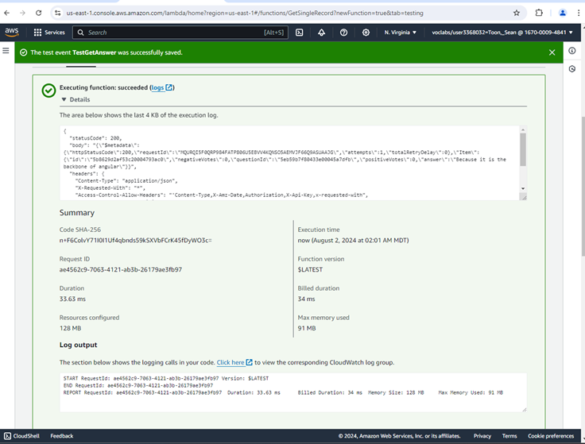

Slide 8
The Serverless Cloud
Database
Differences between MongoDB and DynamoDB
Hosting location
Configuration complexity
Security
Availability
Compatibility
Capacity
Query methods
Data types
Queries performed
Questions and Answers tables
Scripts produced for queries
Notes:
Some of the differences between MongoDB and DynamoDB include:
-MongoDB can be hosted publicly on-premises, DynamoDB cannot.
-MongoDB is difficult to set up, configure and maintain compared to DynamoDB
-MongoDB default configurations are less secure than DynamoDB
-MongoDB is available on different OS’s while DynamoDB is only through AWS hosting
-MongoDB supports a wider range of programming languages
-They support different server-side processing tools.
-Different document size capacity.
-Offer different query operation methods
-MongoDB offers a bigger variety of data types
The queries that I created in my project were for the Question and Answers data tables. I did things such as put, get and delete questions and answers and well as test the queries.

Slide 9
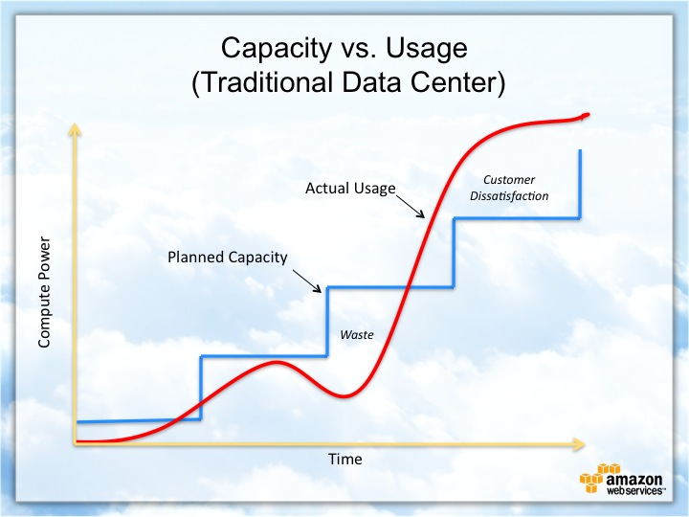
Cloud-Based Development Principles
Elasticity
Scaling
Storage
Resources
Pay-for-use model
Computing
Storage
Data transfer
Notes:
Elasticity is the principle that describes an app that can scale and handle different data loads all while being resourceful, and on demand. The pay-for-use model is a good example of an elastic model because it ensures that developers only pay for resources that are consumed at scale.

Slide 10
Securing Your Cloud App
Access
Policies
API Security
IAM roles and policies
Roles/ Permissions
Policies / LabRole
IAM Roles/Policies
Encryption
Bucket policies
Lambda and the database
S3 Bucket
Notes:
IAM roles and policies are created and implemented to ensure that access within an application are granted to authorized users. The difference between roles and policies is that roles are a set of permissions and policies are the documents that define the permissions. Policies define roles and roles are then assigned to users. The way to secure the connection between Lambda and Gateway is to create the right set of policies and then assign roles to users accordingly. For example, ideally for this project I do not want just any user to have access to S3 buckets or DynamoDB tables. In my project, I was able to use a policy called “LabRole” and all of the necessary permissions were already written for me.

Slide 11
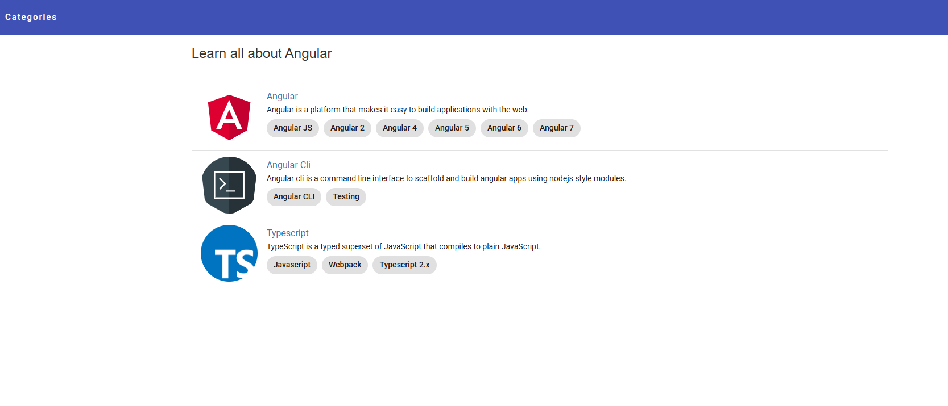
Conclusion
Scalability
Cost Efficiency
Management
Notes:
I can simply conclude that through my experience of migrating to a serverless architecture, I was able to take advantage of many different benefits offered such as scalability, cost efficiency and reduced management.

